Slide 1
Adidas Project Weekly Report
March 18, 2021
By Jinhang Jiang

Slide 2
Network Analysis
Similarity Analysis
Issues Remained

Slide 3
Network Analysis

Slide 4
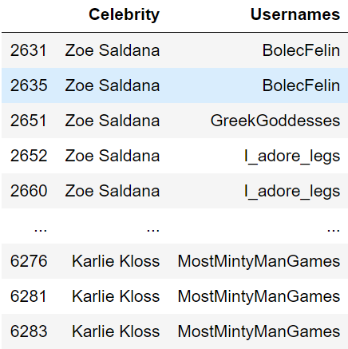
Data
Two columns, the usernames may appear multiple times
All the rest of analysis uses the data in this format

Slide 5
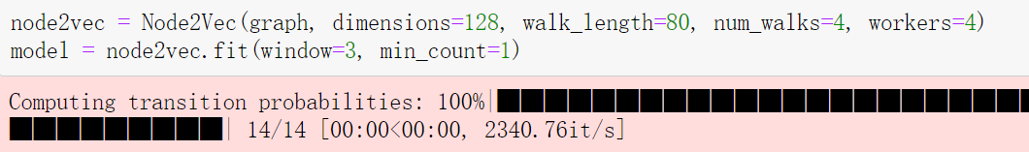
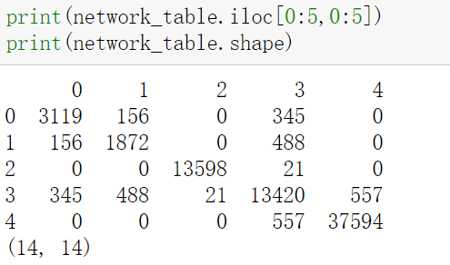
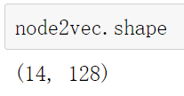
NetworkX and Node2Vec

Slide 6
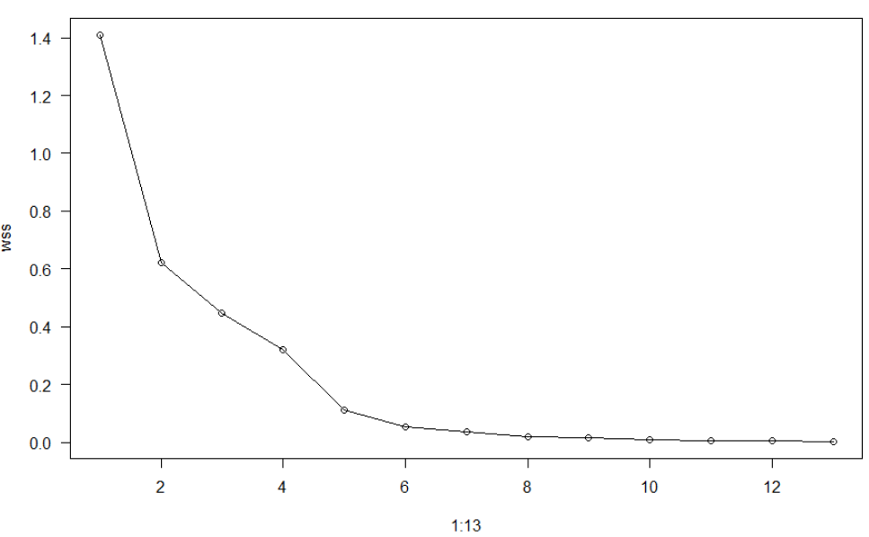
K-means Analysis

Slide 7

K-means Analysis
BSS(k) measures how far apart the clusters are from each other. A good clustering has a small WSS(k) and a large BSS(k).
K = 5

Slide 8
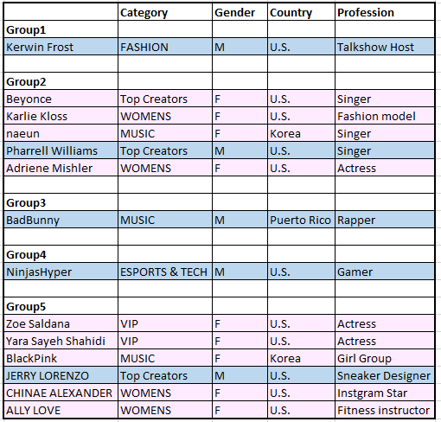
K-means Analysis

Slide 9
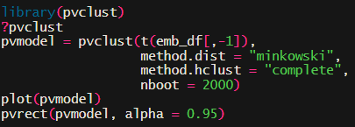
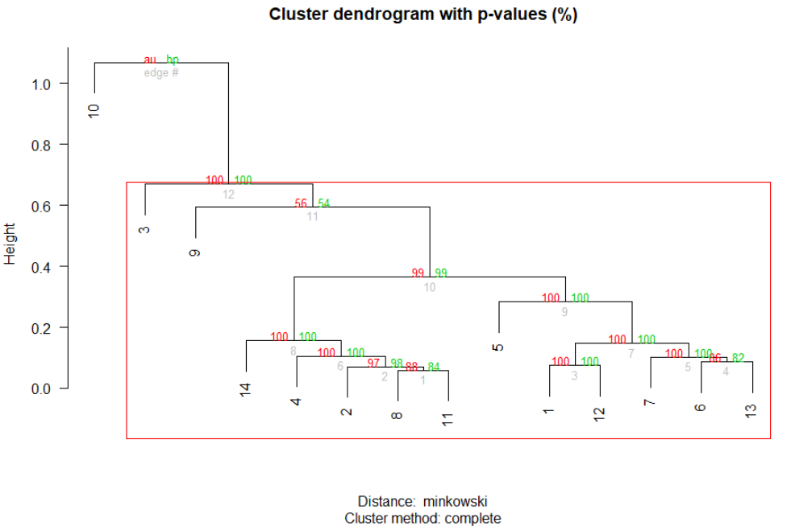
PvClust

Slide 10
Similarity Analysis

Slide 11
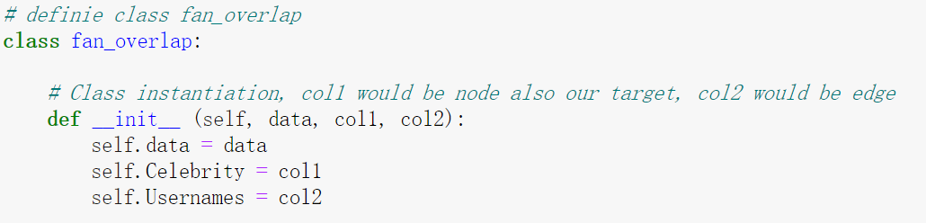
Build a class

Slide 12
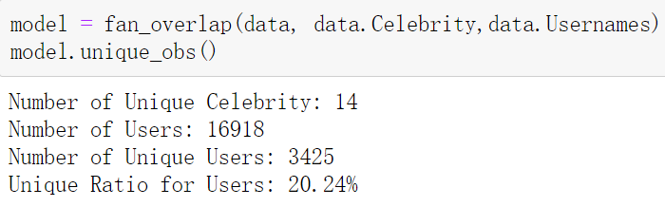
Build a class

Slide 13
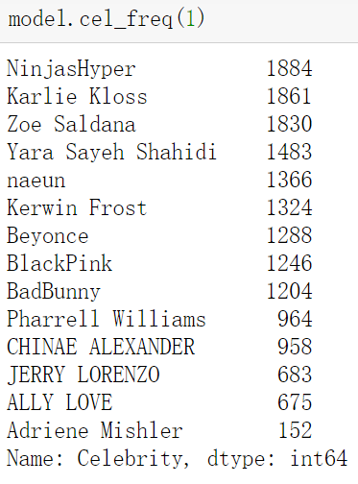
Build a class

Slide 14
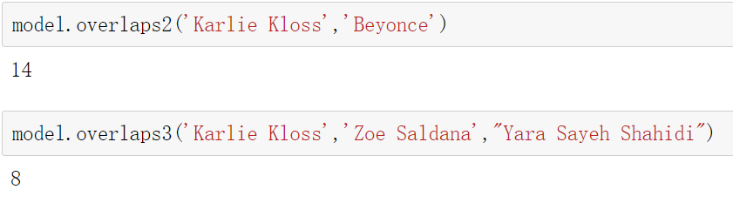
Find the number of fans overlapped

Slide 15
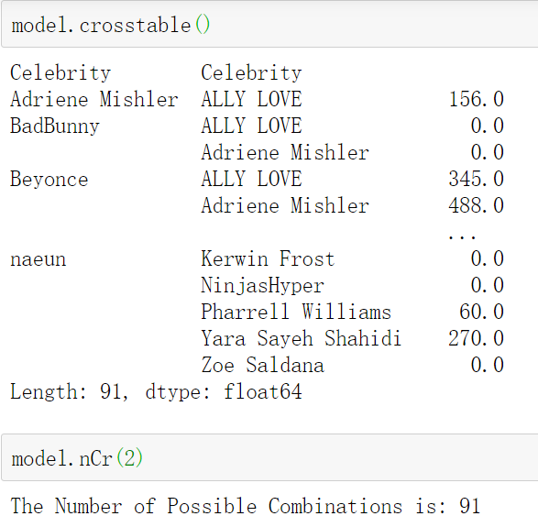
Generate a cross table/ # of possible combinations

Slide 16
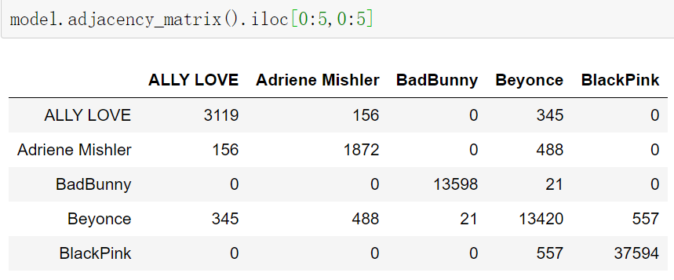
Generate an adjacency matrix

Slide 17
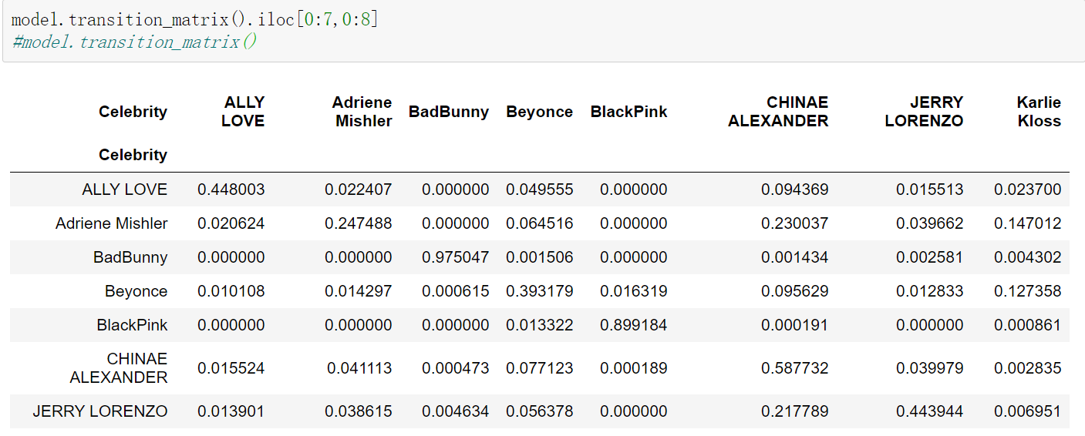
Generate a transition matrix

Slide 18
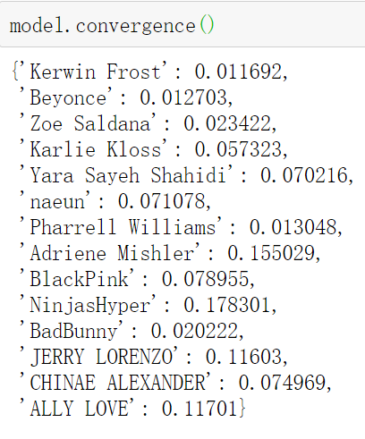
Generate MCL Convergence
Steady state Markov chains is the idea that as the time period heads towards infinity then a two state Markov chain' state vector will stabilise.
--The Engage Wiki

Slide 19
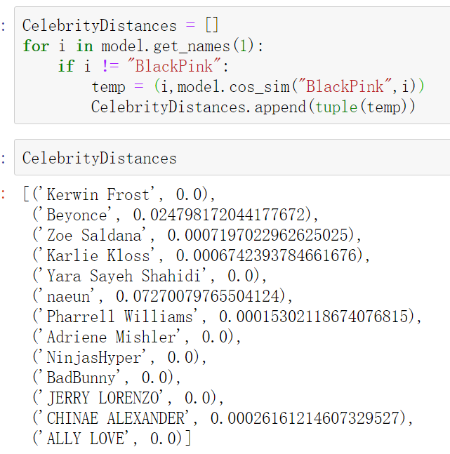
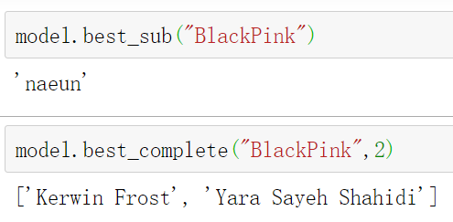
Cosine_Similarity for Recommendation
Cos_sim’s range is (0,1)
For best_sub, we get the largest cos-similarity score
For best_complete, we get the BottomN

Slide 20
Issues Remained
Parameter tuning for node2vec
Similarity method pick
K-means and cos_similarity give us different answer
Pagerank
Case study (for example, Naeun Son vs. Seolhyun)
The data is very biased
Plan to start text mining analysis

